Slide 1


Project 2
Darryl Bunn
Antonio Gomez
Robert Riggs
Jonathan Torres

Slide 2
Requirements
Each team will be tasked with the analysis of a large dataset (10-15 thousand records) using our E-Commerce data structure.
Data should be processed and cleaned using PySpark.
A Power BI report should be created and visualizations shown answering specific analysis questions

Slide 3
TECH STACK
Python
Pyspark
PowerBI

Slide 4
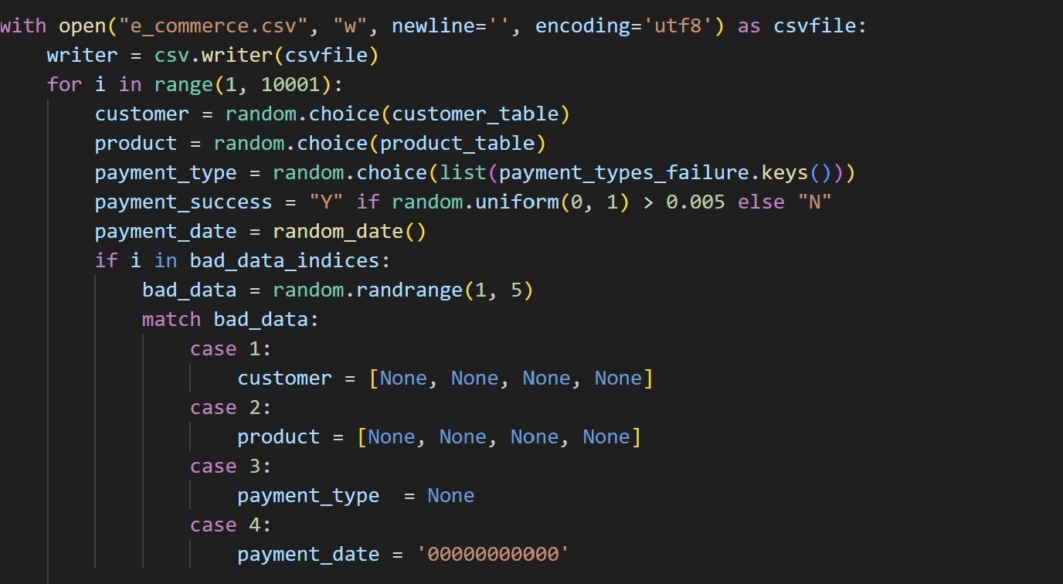
Generating Bad data

Slide 5
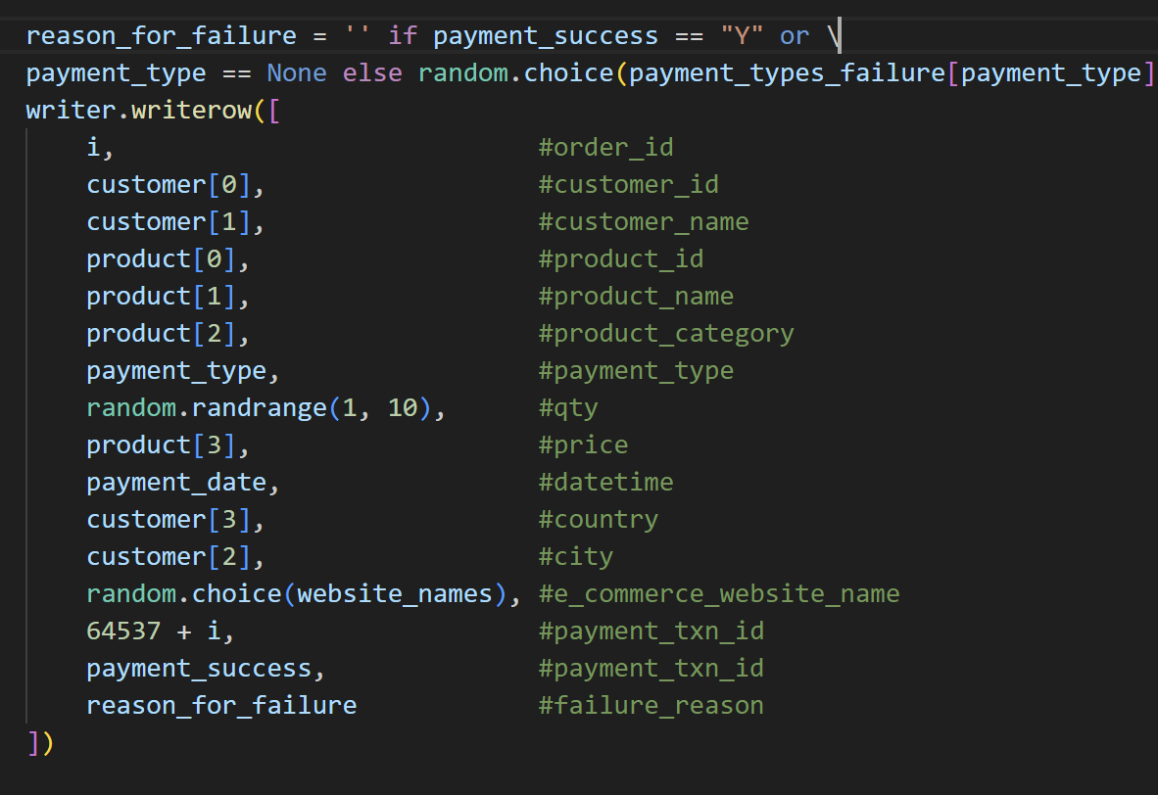
Generating Good Data

Slide 6
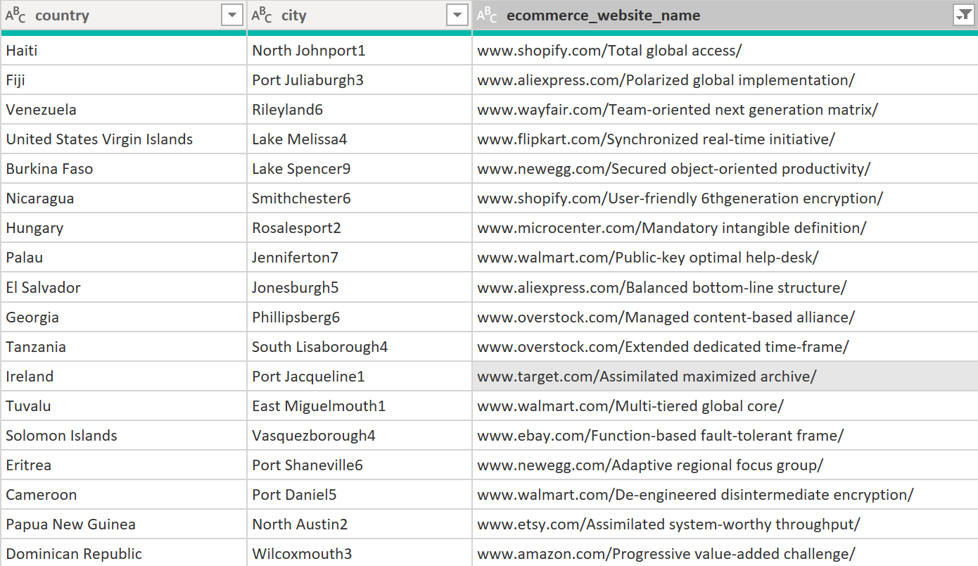
BAD DATA

Slide 7
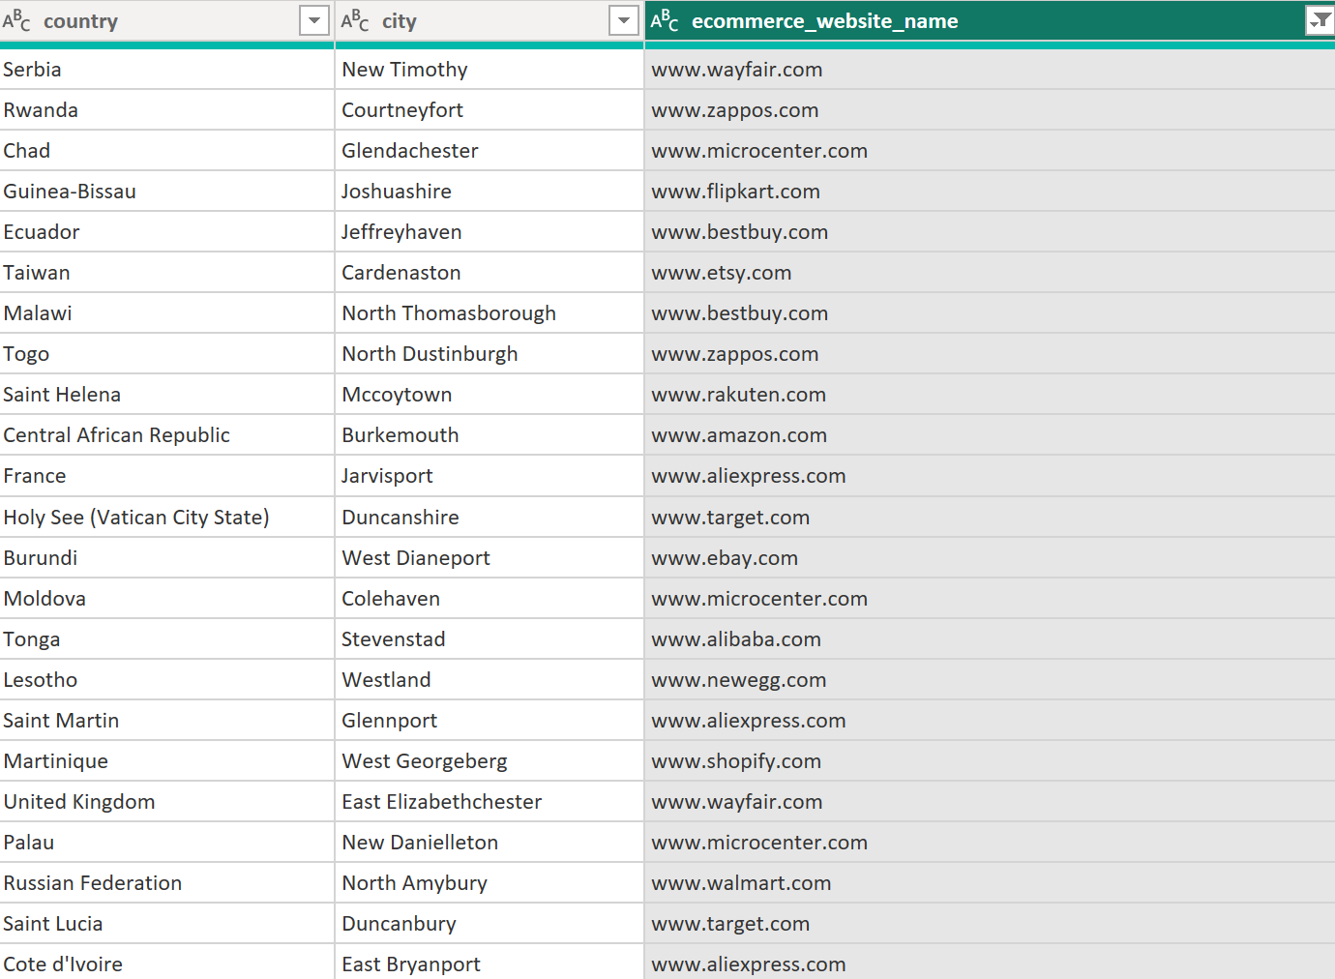
GOOD DATA​

Slide 8

What Categories see the most Sales?

Slide 9
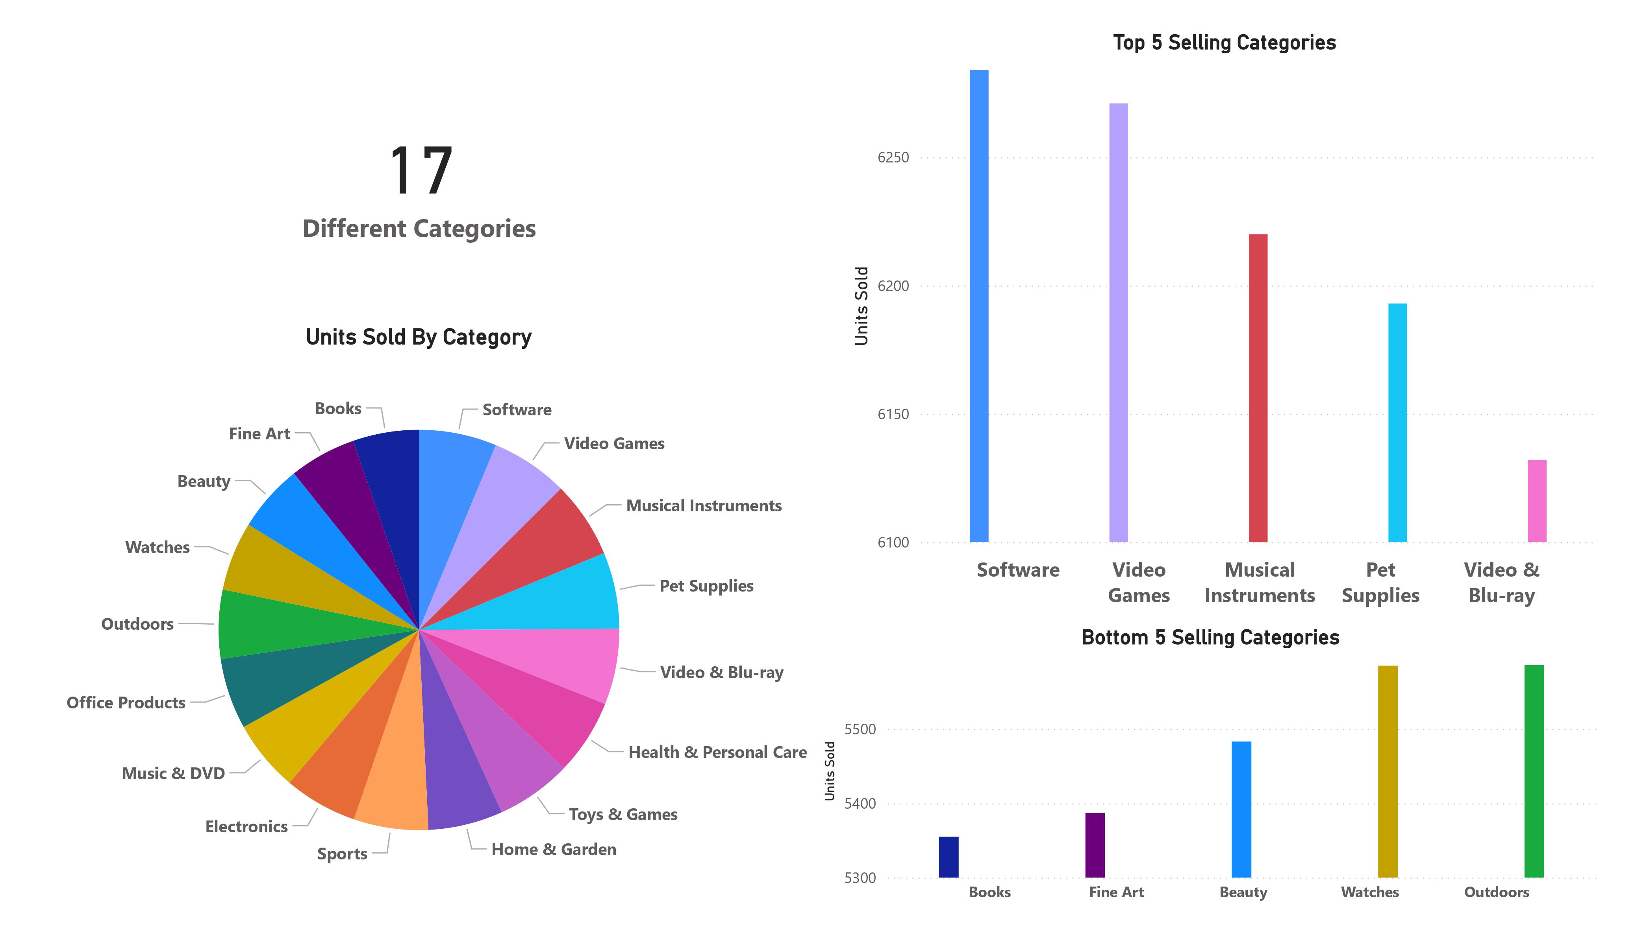

Slide 10
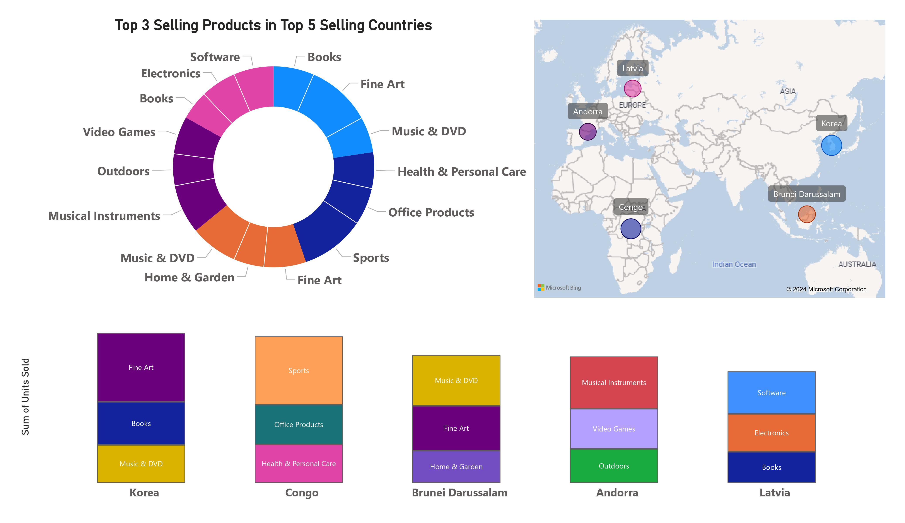

Slide 11
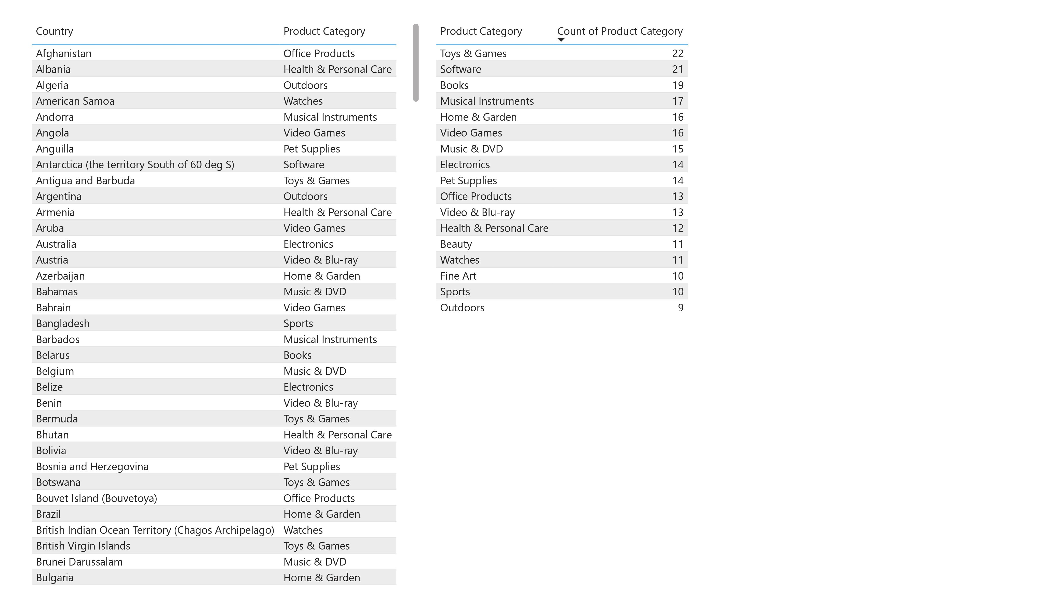

Slide 12

How does the popularity of products change throughout the year?

Slide 13
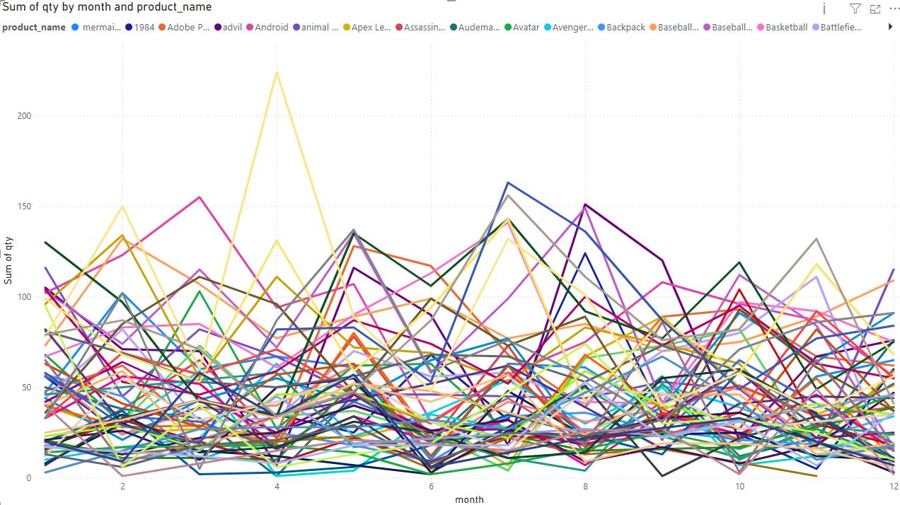
How does the popularity of products change throughout the year?

Slide 14
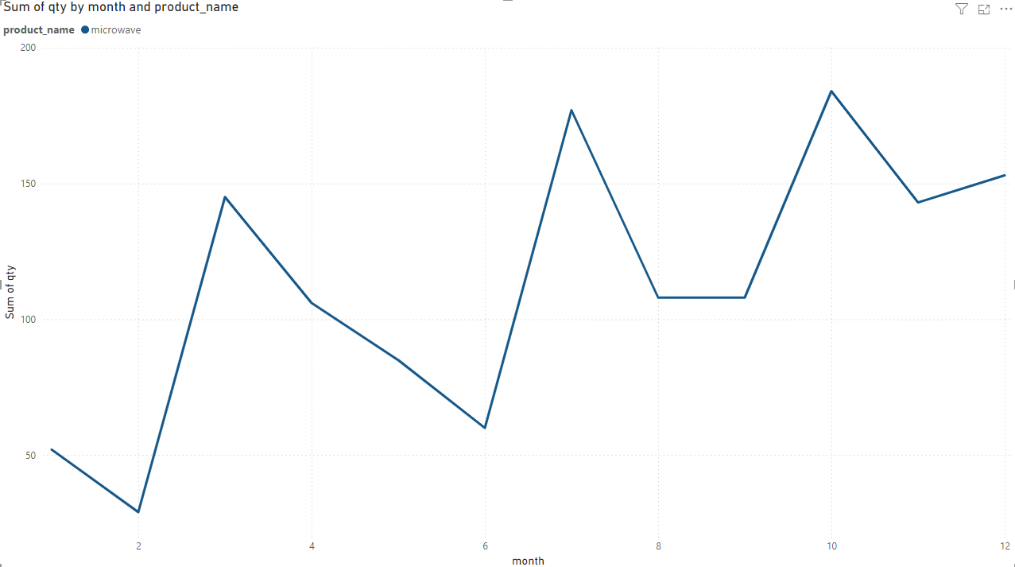
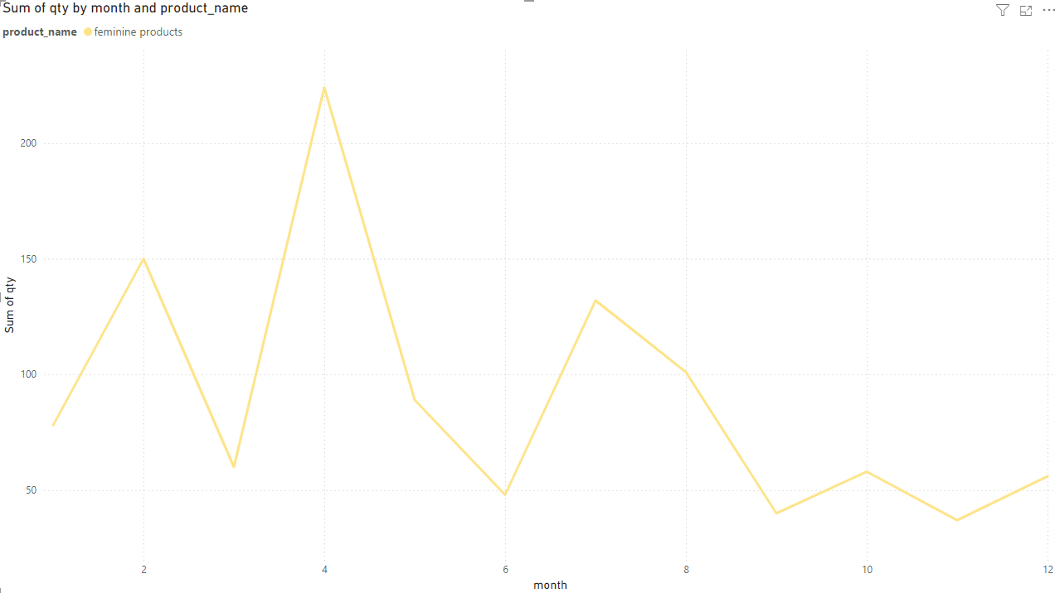
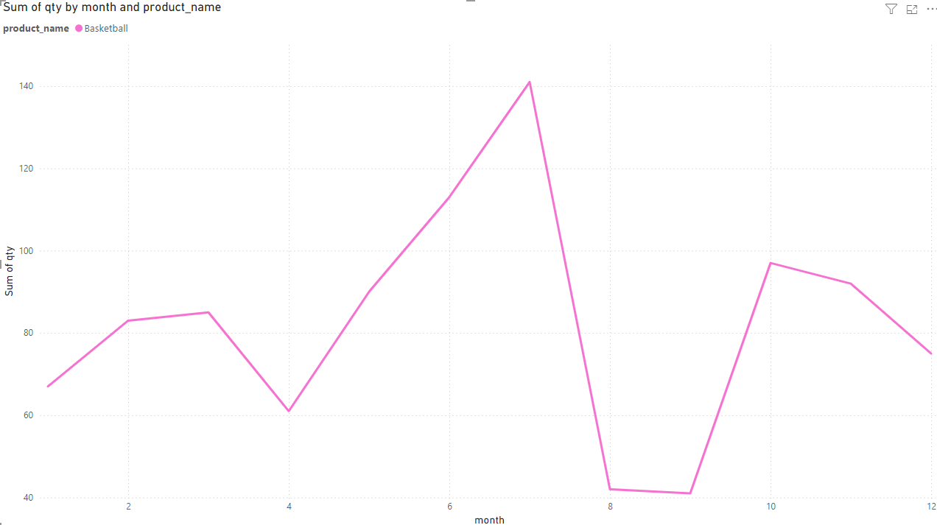
Examples of filtering by certain products

Slide 15
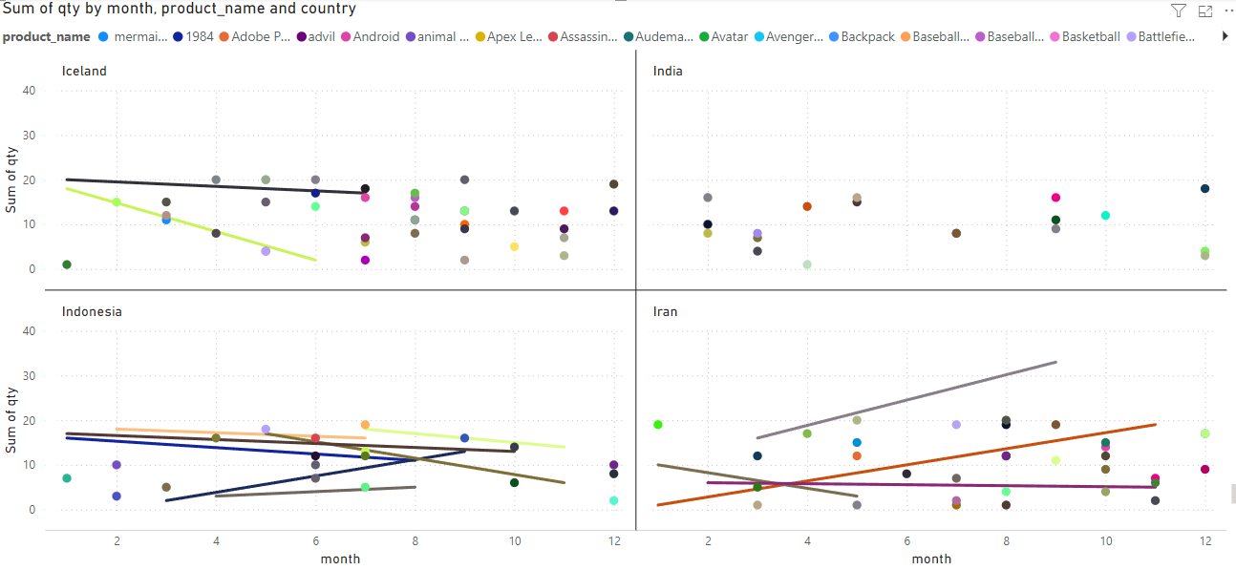
How does the popularity of products change throughout the year, per country?

Slide 16
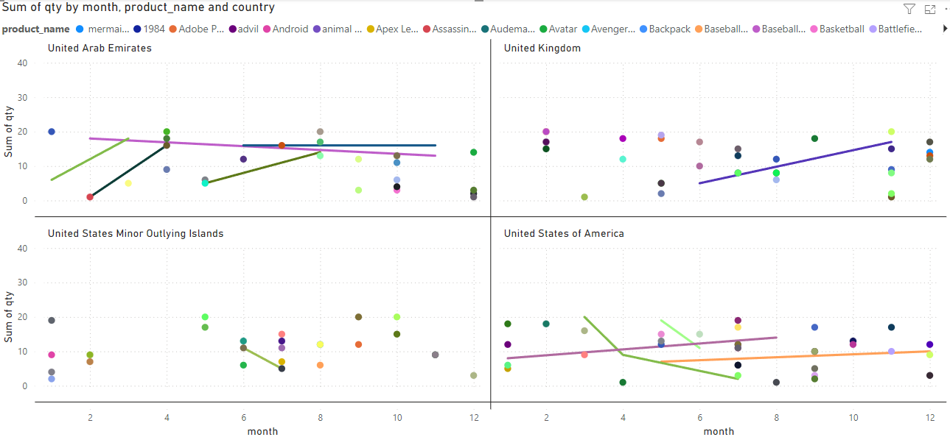

Slide 17
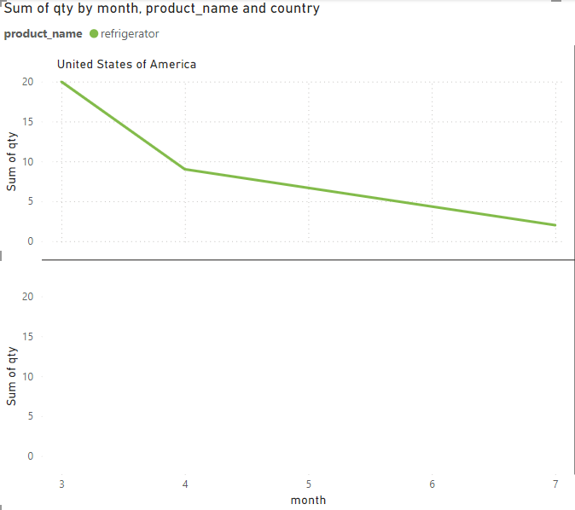
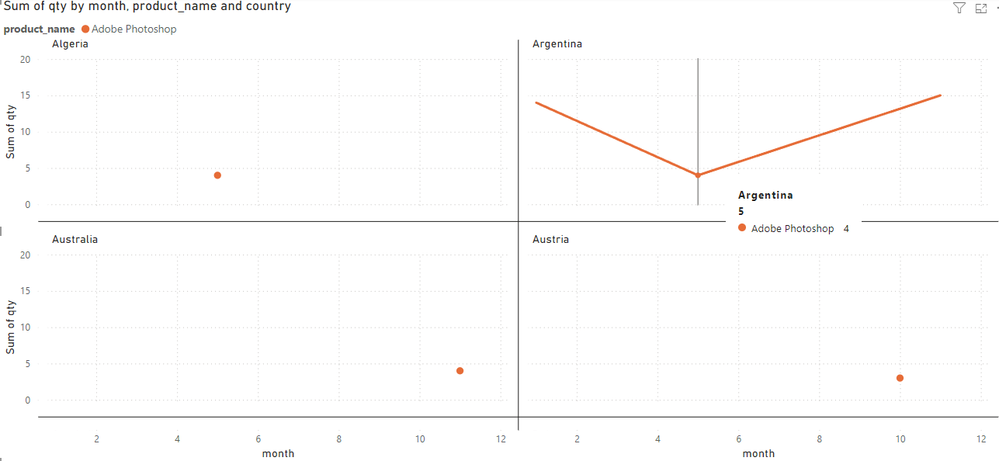
Example of filtering by a specific country and product
Example of filtering by a specific product

Slide 18

Which locations see the highest traffic of sales..

Slide 19
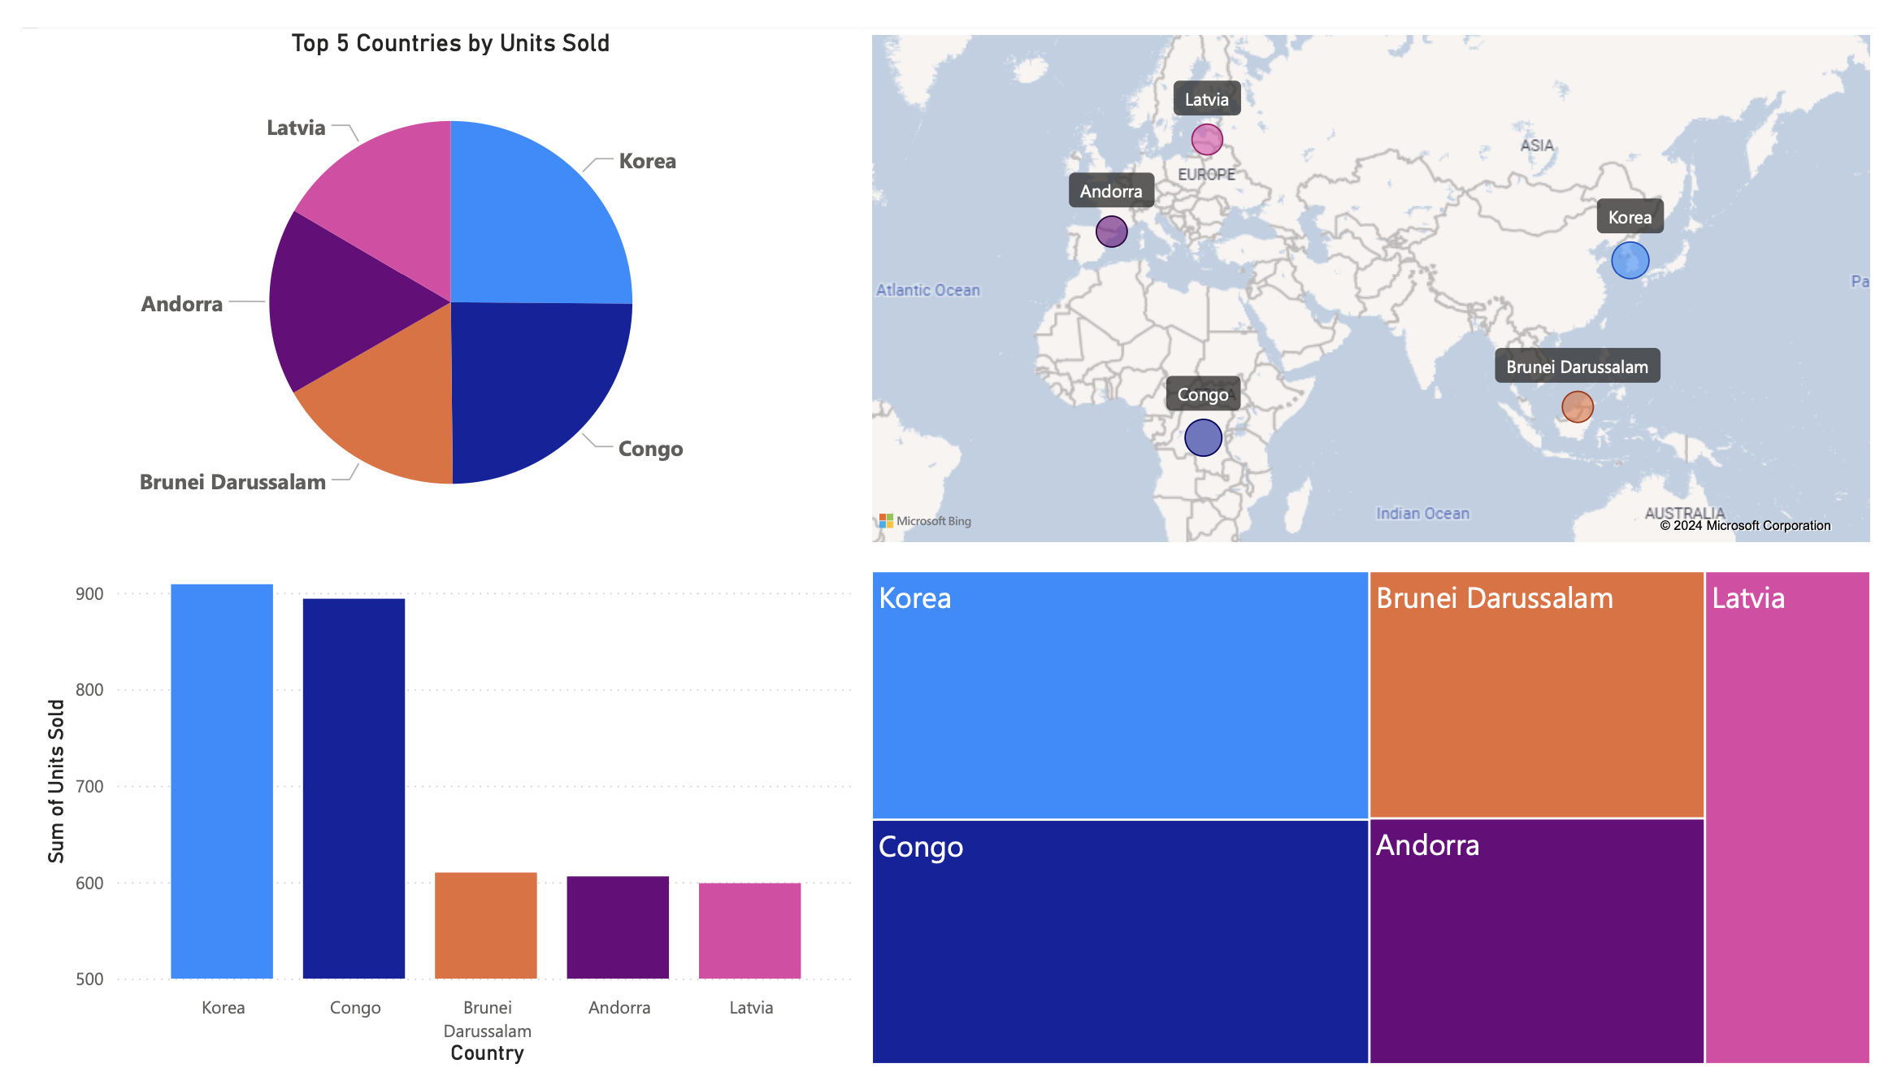

Slide 20
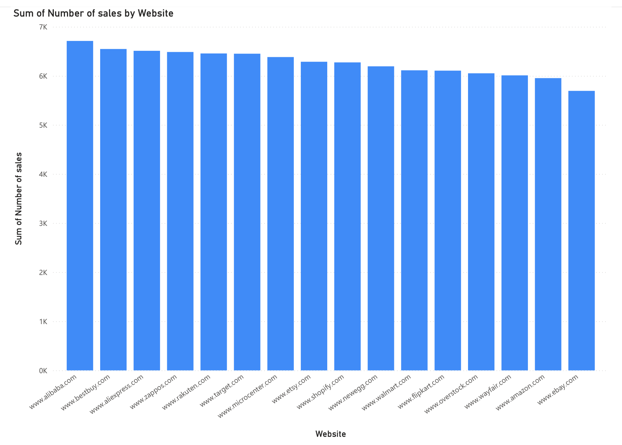
By website

Slide 21
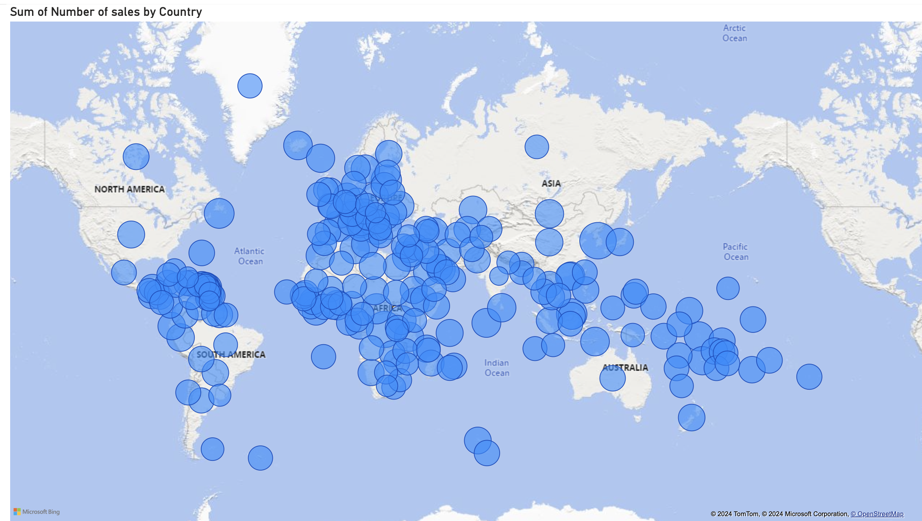
Number of sales by country

Slide 22
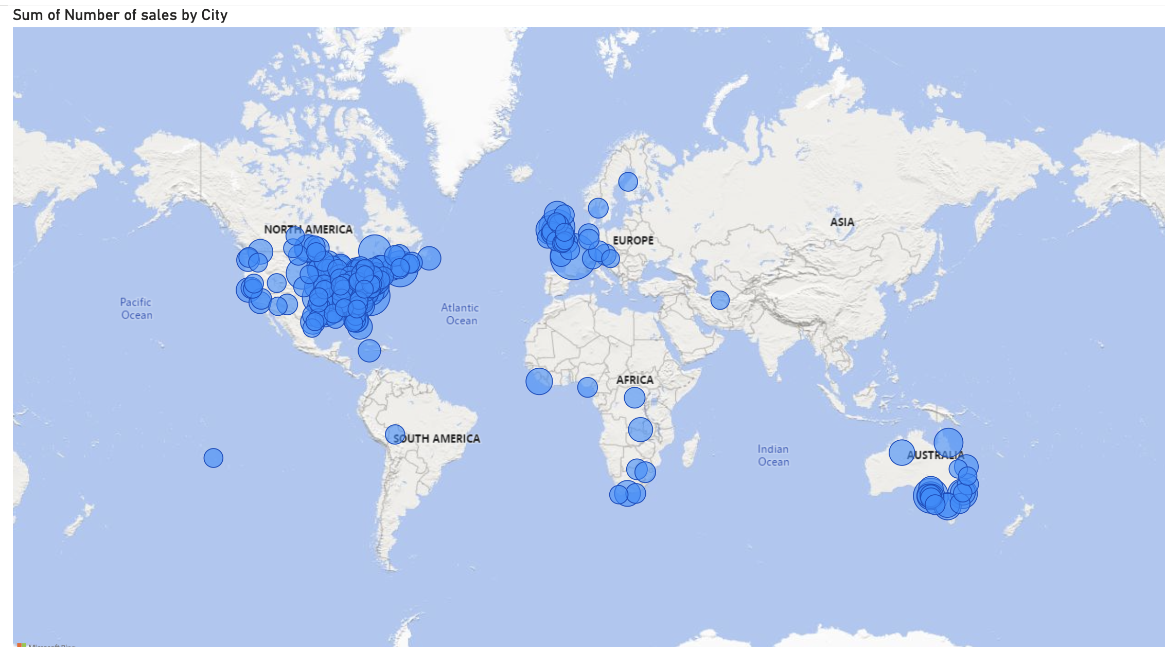
Number of sales by city

Slide 23
What times have the highest traffic of sales? Per country?

Slide 24
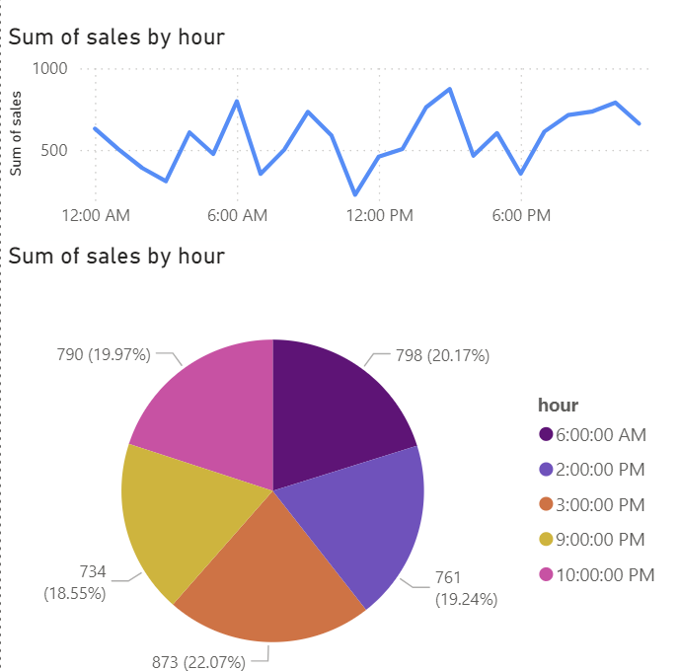
Peak Hours

Slide 25
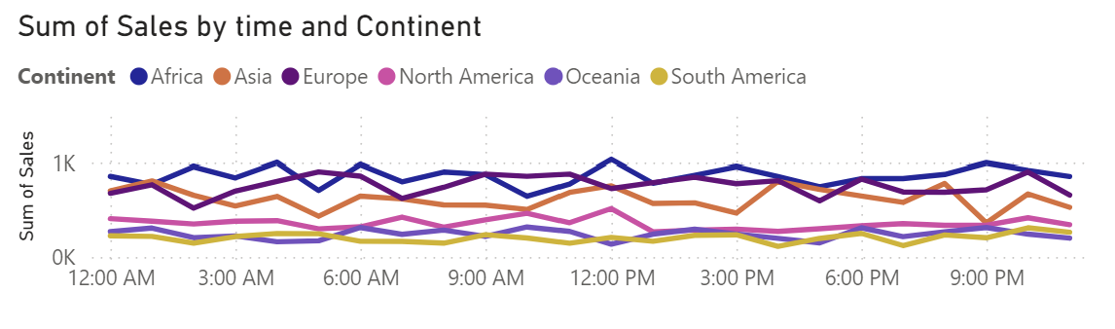
CONTINENT

Slide 26
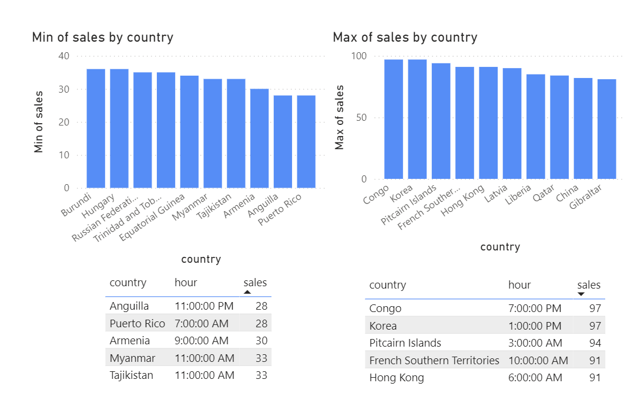
Top Countries
Bottom Countries

Slide 27

Observations
Since most of our sales occur in Asia and Europe, targeting those countries with marketing strategies can yield the greatest return based off geographical location.
While the most selling category of product is Software overall, the top selling category in most countries is Toys and Games. Perhaps with more advertising we can increase those revenue streams.
Different products sell better during varying months of the year due to their individual qualities. Focusing marketing on popular products during the months where their popularity is at its height may boost sales further.
Our data indicates that four out of five peak hours occur after 2 PM. Therefore, to maximize our profit margins, it is best to allocate our resources and focus our marketing efforts during this time frame.

Slide 28

QUESTIONS?

